Slide 1
Low Cost Approach for Teaching 3D Printing and Other Digital Manufacturing Concepts
Sean Davis – Product Development Engineer
Ridge Tool Company
Best Medicine Teacher Workshop 2018

Slide 2
Overview
Introduction
Digital manufacturing methods
3D printing
Hands on activity
Related math problems

Slide 3
What do I mean by digital manufacturing?
CNC Machines
https://youtu.be/I1GZROLRg1w
Laser Cutters
https://youtu.be/SIjUVCho_xU
3D printers
https://youtu.be/m_QhY1aABsE

Slide 4
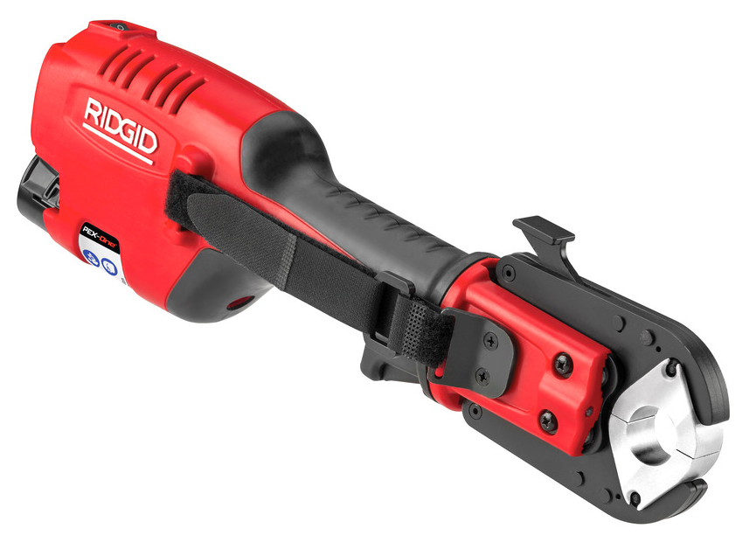
Why is 3D printing AWESOME!!!

Slide 5
Why is 3D printing problematic

Slide 6
There exists a middle ground!

Slide 7
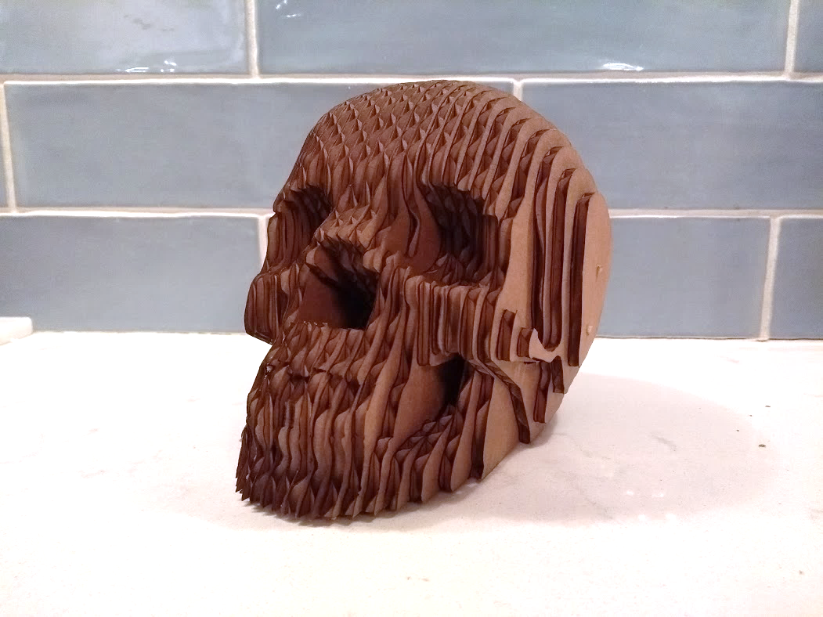
There exists a middle ground!

Slide 8
Required Materials
Cardboard (McMaster Part# 20585T22)
https://www.mcmaster.com/#20585t22/=1c55kyd
Bamboo/Kebab Skewers
Paper Printouts
Scissors
Tape
Pens/Markers

Slide 9
In class activity instructions
Cut out the paper stencil.
Tape the paper to a rectangle of cardboard.
Punch the center of the holes with a thumbtack.
Follow the holes with a bamboo skewer.
Remove bamboo skewer.
Trace the silhouette onto the cardboard.
Remove paper stencil.
Label the cardboard with the layer number.
Cut out the cardboard silhouette.
Stack layers of cardboard in order of layer number

Slide 10
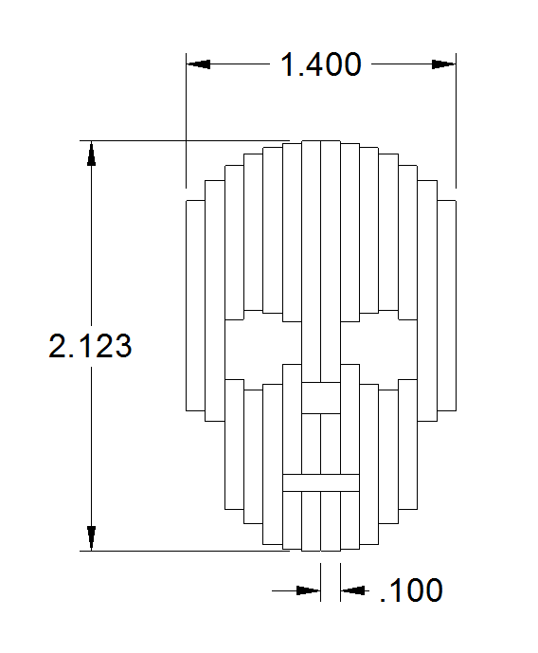
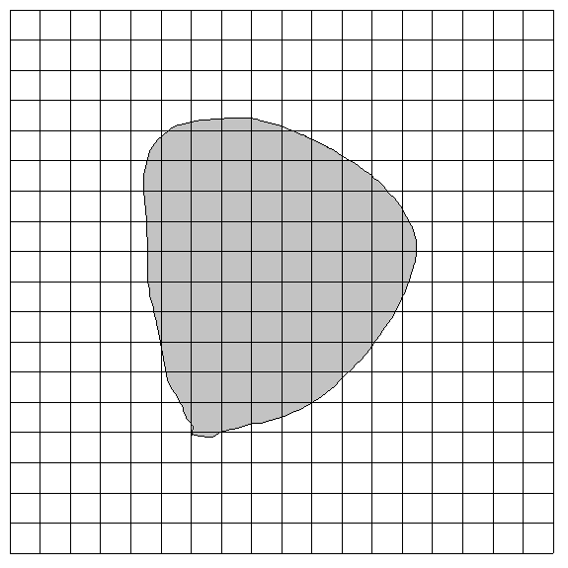
Related Mathematics
Scaling
Area and Volume
Width
Height
Thickness

Slide 11
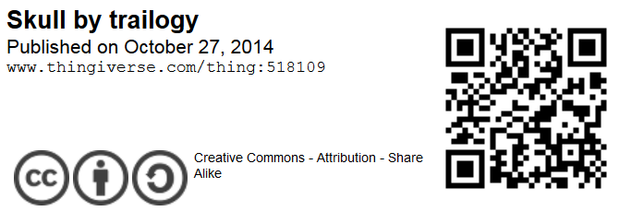
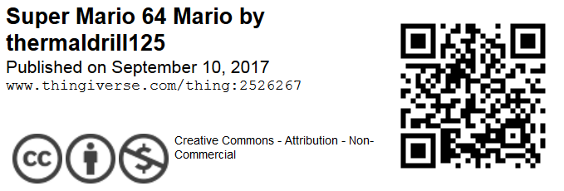
Thanks to the 3D modelers who built the STL files from which the cardboard constructions were built.
Thingiverse.com

